Slide 1
Non-Communicable Diseases
Dr. Dipak Swain
(Professor, GAM, Puri)

Slide 2
Overweight, obesity and dyslipidemia

Slide 3
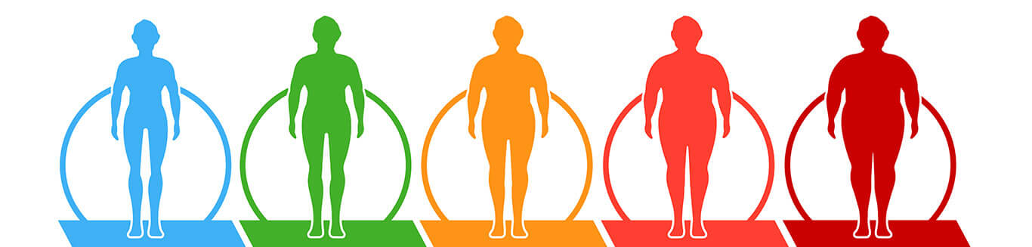
Overweight & Obesity (Medodosha-Medoroga)
Abnormal or excessive fat accumulation that may impair health.
Body Mass Index (BMI) is a simple index of weight-for-height that is commonly used to calssify overweight and obesity in adults.

Slide 4
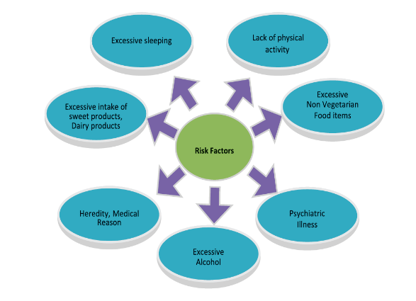
Dyslipidemia
Group of disorders of lipoprotein metabolism, which includes over production or deficiency of lipoproteins or both.
Regarded as primary risk factors for atherosclerotic diseases, especially coronary hearth diseases.
May include elevated LDL cholesterol, triglycerides or both and/or low HDL cholesterol
Risk Factors

Slide 5
Symptoms
Obesity
Breathlessness even on little exertion or physical activity.
Lack of interest in doing work.
Profuse sweating with foul body odor.
Excessive hunger.
Feeling of tiredness.
Excessive sleep.
Dyslipidemia
There are no specific symptoms of elevated lipids, but as it leads to accelerated atherosclerosis, expresses itself in a number of cardiovascular and other diseases.
Angina Pectoris, Coronary artery disease
Myocardial Infarction.
Transient Ischemic Attacks (TIAs).
Cerebrovascular accidents/strokes.
Peripheral artery disease.

Slide 6
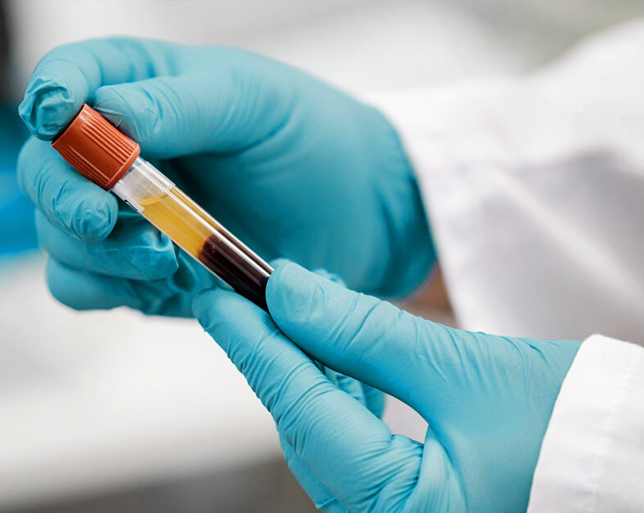
Laboratory Investigations
Lipid Profile
Blood Sugar
Kidney Function Test
Liver Function Test
Blood Pressure checkup

Slide 7
Diagnosis
Obesity
Dyslipidemia
Classification | BMI (kg/m²)
Normal | 18.5 – 22.9
Overweight | 23 – 24.9
Obese | >25
Pre obesity | 25 – 29.9
Obesity Class I | 30 – 34.9
Obesity Class II | 35 – 39.9
Obesity Class III | >40
Blood Lipids | Serum Level (mg/dl)
Total Cholesterol Desirable Borderline high High | <200 200 – 239 >240
LDL Cholesterol Optimal Near Optimal Borderline high High Very High | <100 100-129 130-159 160-189 >190
Blood Lipids | Serum Level (mg/dl)
Serum Triglycerides Normal Borderline high High Very high | <150 150-199 200-499 ≥500
Serum HDL Cholesterol Low High | <40 ≥60

Slide 8
Preventive Measures
Preferred Diet
Take low-fat, low-calorie and high fiber food items
Use warm water for drinking
Include fresh and raw vegetables in daily meal.
Steamed boiled and baked vegetables rather than fried
Take Healthy foods such as –Walnuts, Salads, Bitter Gourd (Karela), Drumstick (Shigru), Barley (Yava), Methi (Fenugreek Seeds), Haldi (Turmeric), Moonga Daal (Green Gram), Bajra (Millets), Honey (Madhu), Indian Gooseberry (Amla), Pomegranate (Anar) and Snake Gourd (Chichinda) etc.

Slide 9
Restricted Diet
High carbohydrate food like – potato, rice etc.
Sugar and sweet products, dairy products, fried and oily foods, fast foods, excess salt and meat of animals of marshy land
Excessive sleep
Alcohol and Smoking
Salty foods or excessive salt in meals

Slide 10
Recommended Lifestyle & Yoga Practice
Lifestyle practices | Brisk morning walk of 45 minutes Yoga and Meditation to manage stress and fatigue Avoid Watching TV while having food Avoid excessive sleep especially during daytime after meal
Yoga practices (As per yoga protocol) | Suryanamaskar, Paschimottasan, Janusirshasana, Tadasana, Katichakrasana, Konasana, Pavanmuktasana Kapalbhatti, Agnisar, Kunjal,

Slide 11
Medication
(As per the Prakriti of the patient and severity of the illness)
Single drug | Shunthi (Zinziber Officinalis) | 1-2 gm B.D.
 | Haridra (Curcuma Longa) | 3-6 gm B.D.
Poly herbal formulations | Trikatu Churna | 1-3gm B.D.
 | Triphala Churna | 3-6gm B.D.

Slide 12
Referral
Obesity requires continuous monitoring of the blood pressure/lipid profile and blood sugar at regular interval and patient self-management education to prevent acute complications and to reduce the risk of long-term complications. However, patients may be referred to the higher center for following conditions-
The patients of uncontrolled Hypertension
The patients of uncontrolled diabetes
Refer to lipid clinic if Total cholesterol ≥240 mg/dl, Triglycerides ≥500mg/dl
Any other systematic uncontrolled co-morbidities

Slide 13
Hypertension

Slide 14
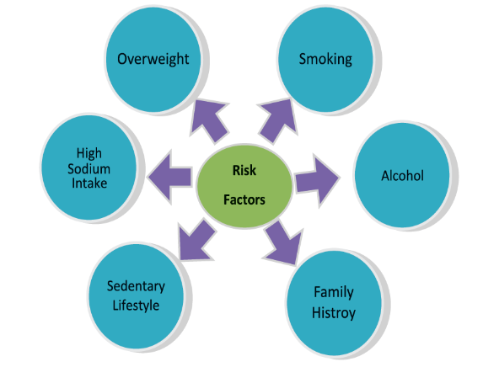
Risk Factors for Hypertension
Hypertension is a condition in which the blood vessels have persistently raised pressure.
Primary Hypertension: It has no known cause however lifestyle factors are associated with this condition.
Secondary Hypertension: It is caused by some other medical condition. Causes include kidney diseases: reno-vascular diseases and chronic renal disease, endocrine disorders: hyperthyroidism, cushing’s syndrome and pheochromocytoma, sleep disorders, coarctation of the aorta and non-specific aorto-arteritis.

Slide 15
Symptoms
The symptoms of High Blood pressure manifest in variety of forms. Some common clinical features are as below-
Early-morning headache
Severe anxiety
Nosebleed
Irregular heartbeats
Vertigo
Symptoms of severe hypertension include tiredness, nausea, vomiting, confusion, anxiety, Chest pain and muscle tremors

Slide 16
Diagnosis of Hypertension
(Source- JNC VIII)
Category | Systolic (Top Number) | Diastolic (Bottom Number)
Normal | Less than 120 | Less than 80
Prehypertension | 120-139 | 80-89
High Blood Pressure
Stage I | 140-159 | 90-99
Stage II | 160 or higher | 100 or higher
Laboratory Examination
  Blood sugar
  Kidney function tests
  Lipid profile
Complications
  Chest pain, also called angina
  Cardiac failure
  Cerebrovascular Stroke

Slide 17
Preventive Measures
Preferred Diet- Barley (Yava), Sorghum (Jowar), Wheat, Green Gram (Mudga/Moong Dal), Bitter Gourd (Karela), Bottle Gourd (Ghia/ Lauki), Turnip (Shalgam), Carrot (Gajar), Indian Gooseberry(Amla), Cucumber(Khira),Draksha, Pomegranate(Anar),SesameOil (TilTaila),etc
Restricted Diet- Excessive use of Butter, Chillies (Red-Green), Pickles, Bengal Gram (Chana Dal), Sour Fruits, Curd, Tea, Coffee and intake of processed/oily foods.
Low Salty Diet
Yogic Practices
Fruits & Vegetables
Pathya
(DO’s)
Mental Relaxation
Low fatty diet
Buttermilk, Barley, Gooseberry

Slide 18
Recommended Lifestyle & Yoga Practices
Medications
Lifestyle practices | Regular blood pressure check-up Regular exercise especially brisk walking Avoid stress Avoid awakening in night
Yoga Practices(As per yogaprotocol) | Tadasana, Bhujangasana, Shashankasana, Shavasana, Nadishodhana, Ujjayi, Shitali, Sitkari and Bhramari.
As per the Prakriti of the patient and severity of the illness
Single Drug | Brahmi (Bacopa Monnieri) | 3gm B.D. )If stress is the cause)
 | Gokshura (Tribulus terrestris) | 3gm B.D.
 | Giloya (Tinospora cardifolia) | 3gm B.D.
 | Amla (Embelica officinalae) | 3gm B.D.
Poly herbal formulations | Drakshavleha | 6-12 gm B.D.
 | Punarnavasava | 15 ml B.D.
Panchakarma | Shirodhara | Herbal medicated liquids
 | Virechana Karma | Therapeutic purgation
 | Basti | Therapeutic herbal enema

Slide 19
Referral
Hypertension requires continuing monitoring of the blood pressure at regular interval and patient self- management education to prevent acute complications and to reduce the risk of long-term complications. However, patients may be referred to higher center for following conditions-
The patients of Hypertensive crisis (BP ≥ 180/110mmHg)
If Hypertension is associated with heart disease, stroke or peripheral vascular disease
Evidence of Left Ventricular Hypertrophy (LVH) on ECG.
Presence of urinary proteinuria
Serum creatinine >1.6mg/dl
Persistent Hypertension (BP ≥ 140/90 mmHg) despite 3 months of treatment.

Slide 20
Prediabetes & Diabetes

Slide 21
Prediabetes
Prediabetes is a state of intermediate hyperglycaemia using two specific parameters, impaired fasting glucose (IFG) defined as fasting plasma glucose of 6.1-6.9 mmol/l (110 to 125 mg/dl) and impaired glucose tolerance (IGT) defined as 2 hours plasma glucose of 7.8-11.0 mmol/l (140-200 mg/dl) after ingestion of 75 g of oral glucose load or a combination of the two based on a 2 hours oral glucose tolerance test.
The American Diabetes Association (ADA) includes HbA1c between 5.7 and 6.4 per cent in addition to IGT of 140-200 mg/dl and uses a lower cut-off value for IFG between 100 and 125 mg/dl.
Ayurveda Perspective:
According to Ayurveda pre-diabetes can be considered as one of the Medopradoshaja Vikaara (disorders of fat metabolism) and Prameha Purvroopa Avastha (premonitory sign and symptoms of Diabetes) based upon the sign and symptoms and pathogenesis.
Burning of palm and soles
Excessive stickiness of skin in general and face inparticular
Heaviness of body
Frequent, excessive and turbid urination
Tiredness
Excessive thirst
Foul smell inbreath
Coating of teeth

Slide 22
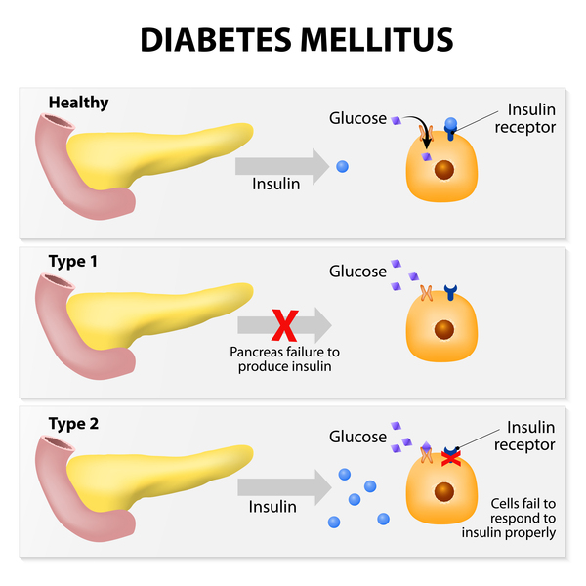
Diabetes Mellitus
Diabetes Mellitus (DM) is a chronic disease, which occurs when the pancreas does not produce enough insulin, or when the body cannot effectively use the insulin it produces. This leads to an increased concentration of glucose in the blood (hyperglycaemia).
Type 1 Diabetes- develops when the body immune system destroys pancreatic beta cells.
Type 1 diabetes may account for 5% to 10% of all diagnosed cases of diabetes.
Risk factors for type 1 diabetes may include autoimmune, genetic, and environmental factors.
Type 2 Diabetes- usually begins as insulin resistance, a disorder in which the cells do not use insulin properly. As the need for insulin rises, the pancreas gradually loses its ability to produce insulin.
Type 2 diabetes is associated with older age, obesity, family history of diabetes, history of gestational diabetes, impaired glucose metabolism, physical inactivity, and race/ethnicity.

Slide 23
Symptoms
Diagnosis and Laboratory Investigations
Excessive thirst
Excess urination
Excess hunger with loss of weight
Frequent infections
Non-healing wounds
Lassitude
Fatigue
Impotency in men
Criteria for diagnosis of T2DM using venous blood samples
American diabetic association
 | Fasting Glucose | 2 hr post-glucose load
 | (mg/dl) | (mg/dl)
Diabetes Mellitus | ≥126 | ≥200
Impaired fasting glucose | ≥110 to <126
 | Values
75g OGTT 2hr plasma glucose | ≥200mg/dl
HBA1C | ≥6.5%

Slide 24
Complications
Cardiovascular disease (Coronary artery disease)
Nerve damage(Neuropathy)
Kidney damage(Nephropathy)
Eye damage(Retinopathy)
Diabetic Foot ulcer
Skin infections
Acute emergencies like:
Diabetic ketoacidosis
Hypoglycemia/Hyperglycemia
Diabetic coma

Slide 25
Preventive Measures
Preferred Diet- Purana Shali (Oryza sativa: Rice),
Purana Godhuma (Triticum sativum; Wheat),
PuranaYava (Hordeum vulgare;Barley),
Tila (Seasamum Indicum; Gingely),
Chanaka (Cicer artenium; Chick Pea),
Kulatha (Dolichos biflorus; Horse Gram),
Mudga (Phaseolus mungo; Greengram),
Sarshapa (Brassica campestris; IndianColza),
Masoora (Ervum Lens; Lentil),
Karavellaka (Momordica charantia; BitterGourd),
Palaka (Spinacia oleacea; Spinach),
Lashuna (Allium sativum),
Jambu (Syzygium cumni),
Trapusa (Cucumis sativus; Cucumber),
Tarabooja (Cucumis melo; Melon),
Dadima (Punica granatum),
Jambhira (Citrus lemon; Lemon),
Shrungataka (Trapa bispinosa;WaterChestnut),
Amalaki (Phyllanthus emblica),
Takra (ButterMilk),
TilaTailaand Sarshapa Taila (Brassicacampestris).

Slide 26
Restricted Diet
Sugarcane juice,
sugar,
milk and milk products,
sedentary lifestyle,
sleeping in the day time and excessive sleeping,
alcohol,
staying too long on empty stomach,
cold drinks,
ice cream,
fast foods,
bakery items,
animal products and meat of animals of aquatic and marshy land etc.

Slide 27
Recommended Lifestyle & Yoga Practices
Medications
Lifestyle practices | Regular exercise especially brisk walking Avoid stress Avoid sleeping in the daytime
Yoga Practices(As per yogaprotocol) | Vakrasana, Mandukasana, ArdhaMatsyendrasana, Suryanamaskara, Paschimottanasana, Kapalbhatikriya
As per the Prakriti of the patient and severity of the illness
Single Drug | Ashwagandha (Withania somnifera) | 3-6 gm B.D.
 | Bhumyamalaki(Phyllanthus niruri) | 3-6 gm B.D.
 | Brahmi (Bacopa monnieri) | 1-3gm B.D.
 | Guduchi (Tinospora cordifolia) | 3-6 gm B.D.
 | Nimba (Azadirachta indica) | 1-3gm B.D.
 | Amalaki (Phyllanthus emblica) | 3-6 gm B.D.
 | Gokshura (Tribulas terresteris) | 3-6 gm B.D.
 | Bilva (Aeglemarmelos) | 3-6 gm B.D.
Poly herbal formulations | Trikatu Churna | 1-3gm B.D.
 | Triphala Churna | 3-6gm B.D.
 | Gokshuradi Guggulu | 1 gmB.D.
 | Kaishore Gugullu | 2 gm BD
 | Nisha-Amalaki | 6gm BD

Slide 28
Referral
Diabetes is a chronic illness that requires continuing medical care and patient self-management education to prevent acute complications and to reduce the risk of long-term complications. However, patients may be referred to higher center for following conditions:
    Serious metabolic derangement or diabetes complication that is left untreated would lead to need for hospitalization, or which requires immediate hospitalization.
    Newly diagnosed Type 1 with or without urinary ketones.
    Decompensate Type 1 or Type 2 diabetes with strongly positive urinary ketones present, dehydration or vomiting.
    Foot ulcer with infection.
    Type 1 or Type 2 diabetes with suboptimal diabetes control after providing treatment (HbA1c>7.0%).
    Marked or symptomatic hyperglycemia not responding to current therapy.
    Recurrent severe hypoglycemia.

Slide 29
CANCER
Prevention measures
Create awareness about the health hazards of tobacco and advocate avoidance
Encourage and assist habitual tobacco users to quit the habit
Promote healthy dietary practices and physical activity
Make your health institute tobacco free and implement Cigarettes and Other Tobacco Products (COTPA) act 2003 effectively as per National Tobacco Prevention Programme

Slide 30
Cancer
Prevention measures
Create awareness about the health hazards of tobacco and advocate avoidance
Encourage and assist habitual tobacco users to quit the habit
Promote healthy dietary practices and physical activity
Make your health institute tobacco free and implement Cigarettes and Other Tobacco Products (COTPA) act 2003 effectively as per National Tobacco Prevention Programme
Early Detection
Create awareness about the early warning signs of cancer
Encourage breast cancer awareness and early screening for the same
Encourage oral self-examination
Create awareness about symptoms of cervical cancer and motivate females for Visual Inspection with Acetic Acid (VIA)screening
Examine, as a routine, the oral cavity of patients with the history of tobacco use
Offer clinical breast examination to any woman over 30 years presenting to the health centre
Refer the women for screening for cervical cancer to the nearest PHC

Slide 31
Oral Cancer
Tobacco chewing is the single most important risk factor for oral cancer. Other risk factors include alcohol use, betel nut chewing, and chronic trauma to oral mucosa by sharp tooth or ill-fitting dentures. Chronic exposure to these risk factors causes changes in the oral mucosa and these changes are visible as pre- cancerous lesions.
Non-healing mouth ulcer–Look for unhealed mouth ulcer of more than 2 weeks and refer him/her to nearest PHC.
Referral
Examine whether the person is able to open the mouth (four finger test), if not then refer him to nearest PHC.
Leukoplakia:
This is defined as a white patch that cannot be characterized as any other disease clinically or pathologically.
Erythroplakia:
This is a bright, velvety area sometimes surrounded by faint plaques which cannot be characterized as any other lesion clinically or pathologically.
Non-healing mouth ulcer:
Look for unhealed mouth ulcer of more than 2 weeks and refer him/her to nearest PHC.

Slide 32
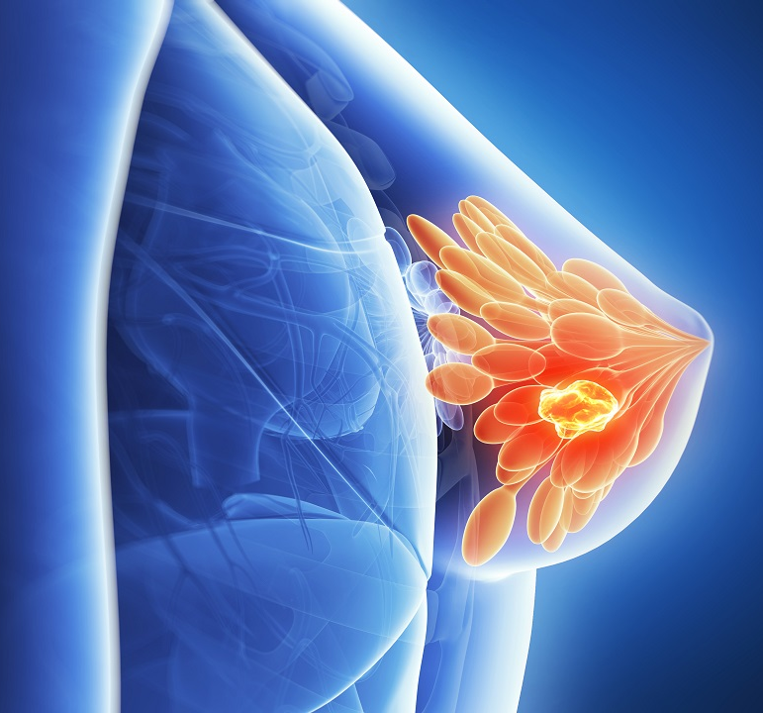
Breast Cancer
Prompt diagnosis of breast cancer in early stage is very important. This is possible by increasing the level of awareness among women.
Breast awareness:
A change in size
A nipple that is pulled in or changed in position or shape
A rash on or around the nipple
Discharge from one or both nipples
Puckering or dimpling of skin
Lump or thickening in the breast
Constant pain in the breast or armpit
All women>30years should be sent to PHC and then screened using Clinical Breast Examination (CBE).

Slide 33
Cervix Cancer Symptoms
Irregular, intermenstrual (between periods) or abnormal vaginal bleeding after sexual intercourse or bleeding after menopause;
Bleeding after douching, or after a pelvic exam;
Vaginal discomfort or odorous discharge from vagina, the discharge may contain some blood and may occur between periods or after menopause.
Pain during intercourse.
(These signs and symptoms are not specific, may be present in other conditions also, but still it is advised to consult health care professional at earliest. More severe symptoms may develop at advanced stages of cervical cancer.)
All women above 30 years of age should be referred to nearest PHC for the screening of cervical cancer.

Slide 34
Thank You.

